Slide 1
Instructions For
Customizing Templates
To save a slide as a PDF, ready to print:
Click File >> Export
Choose “PDF” from the file format dropdown box
Select “Save Current Slide Only”
Select where to save it and click “Export”
Questions?
Reach out to support@livesafemobile.com.

Slide 2


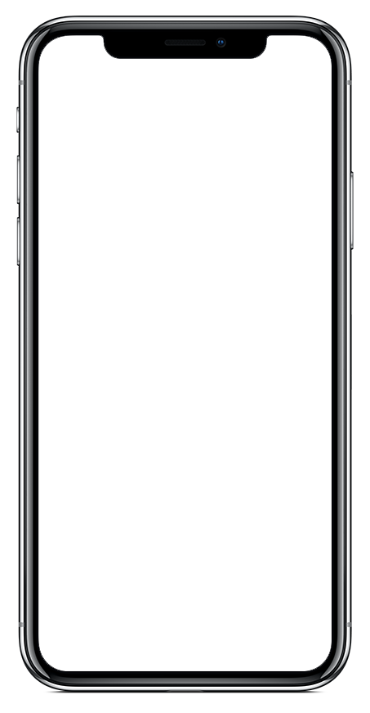
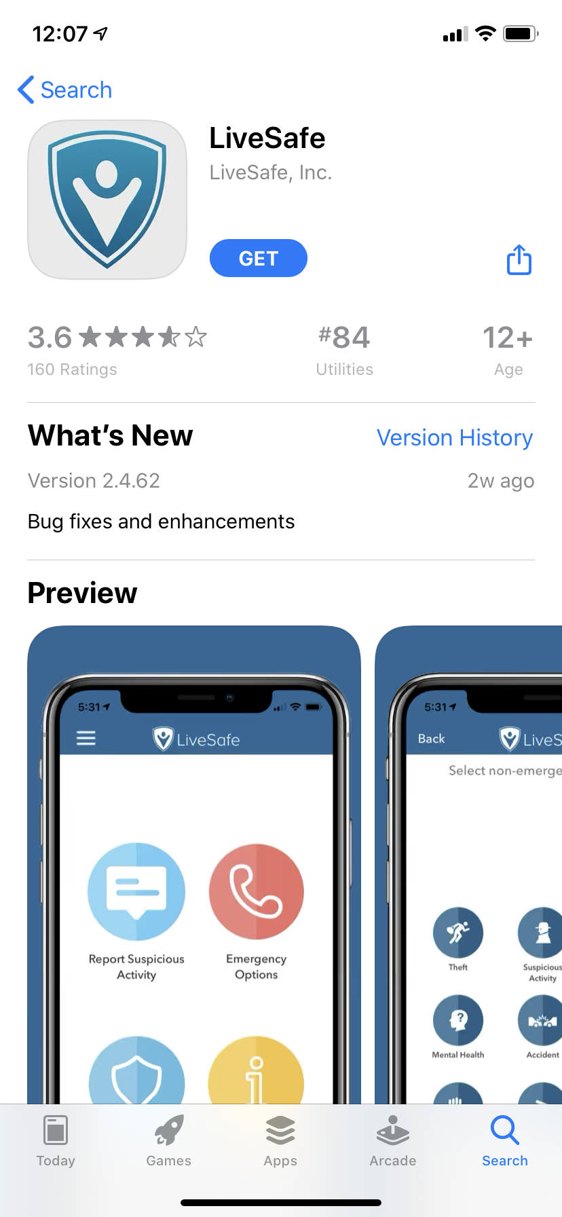
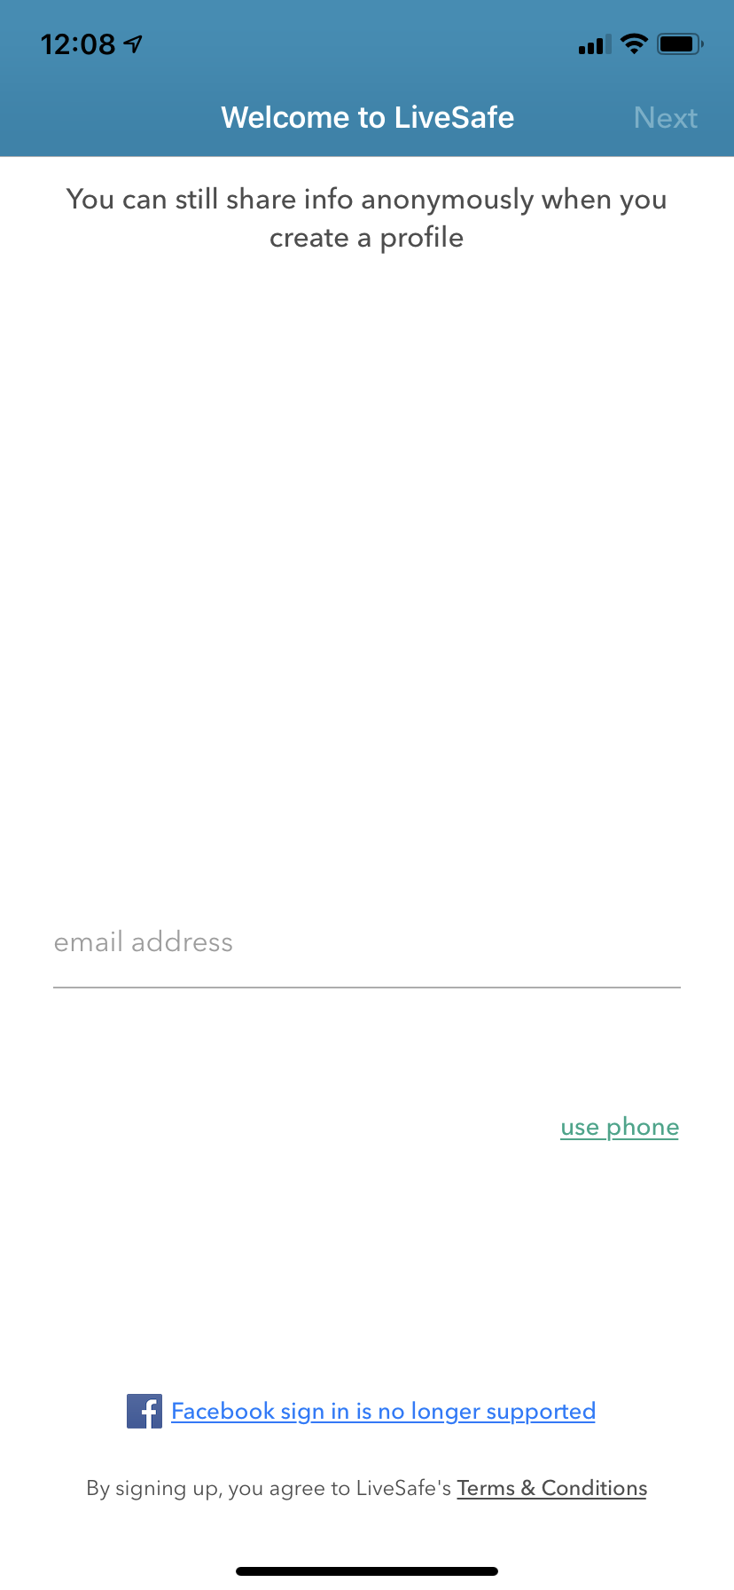
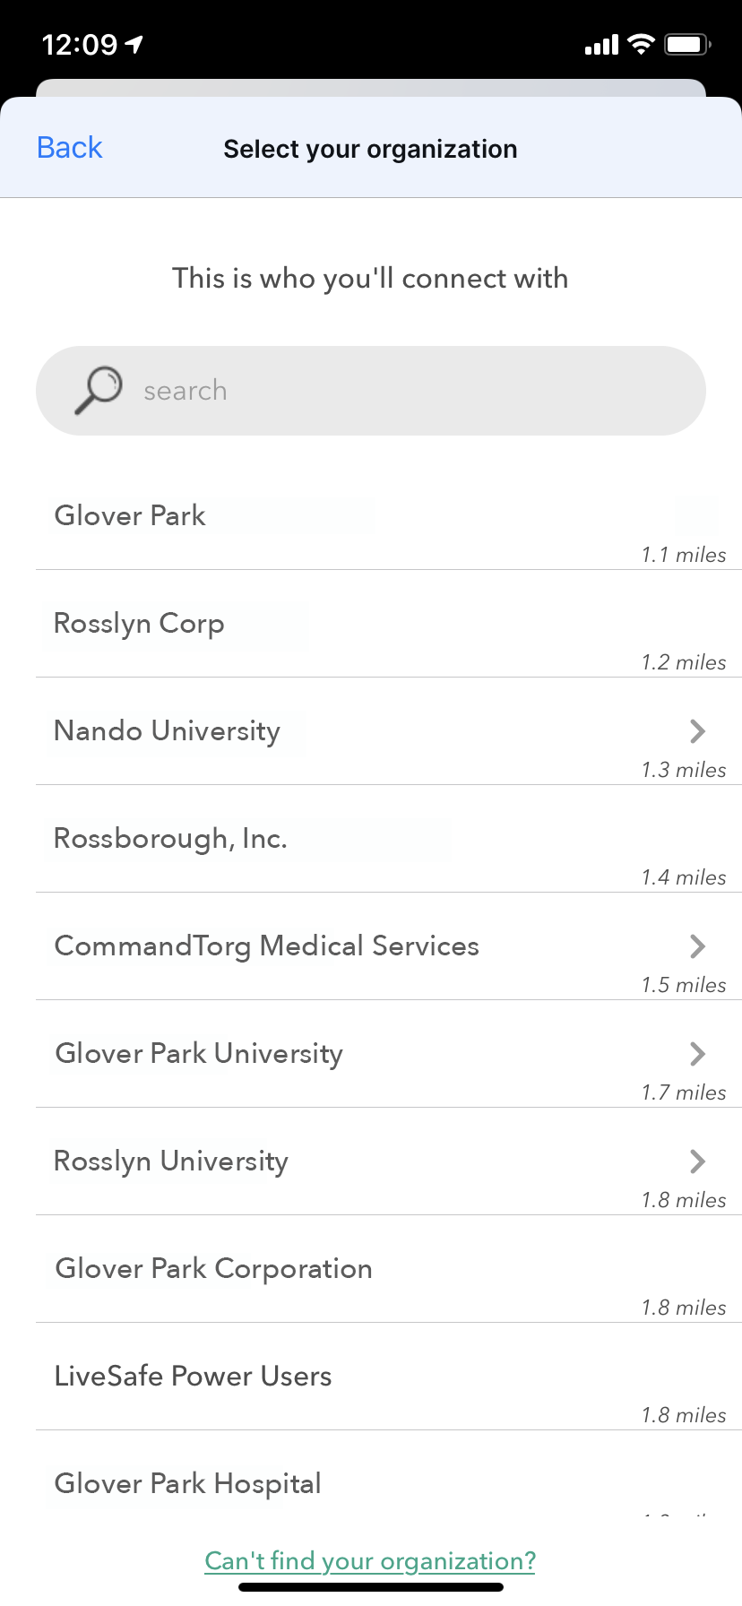
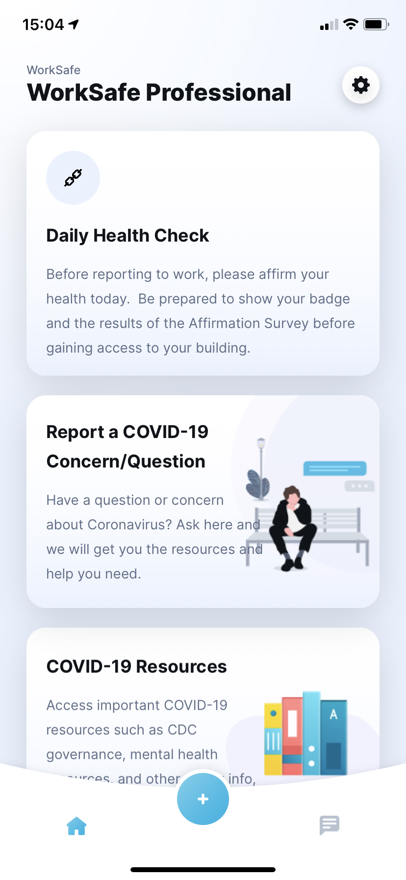
Download LiveSafe &
Access WorkSafe
1
2
3
4
APP STORE
Download “LiveSafe” from Google Play or the App Store
PROFILE
Register with your mobile number & organization email
CONNECT
Search for & select your organization
WORK SAFE
Complete the daily check in or health survey, access CDC COVID-19 information, or ask a COVID-19 question.
Application Deeplink: Link
Having issues accessing WorkSafe via the LiveSafe Mobile App? Reach out to support@livesafemobile.com
Notes:
To Replace “Your Organization” With The Name Of Your Company:
Click “Edit” from the menu bar
Select “Find” and then “Replace” from the dropdown
Under ‘Find What:’ type in “your organization”
Under ‘Replace With:’ type in the name of your company and click “Replace All”
To Replace the “Logo Placeholder” With Your Organization’s Logo In The Header:
Right-click the middle of the “fake logo” image, to the right of the Live Safe logo
Select “Change Picture”
Select the light/white version of your organization’s logo (to be used on darker backgrounds). Make sure you are selecting a PNG for the file type.
To Replace Phone Screen With Your Organization’s Configuration:
Right-click the middle of the home screen image
Select “Change Picture”
Select an image of your home screen configuration from your computer. Ideally, the screenshot was taken using an iPhone X or later. If you don’t have access to an iPhone X, reach out to support@livesafemobile.com.
To Change Color For Footer Banners:
Click edge of blue box
Click “Shape Format” tab
Click “Shape Fill”
Choose a preset color or to select a custom color, click ”More Fill Colors” and enter in hex code

