Slide 1
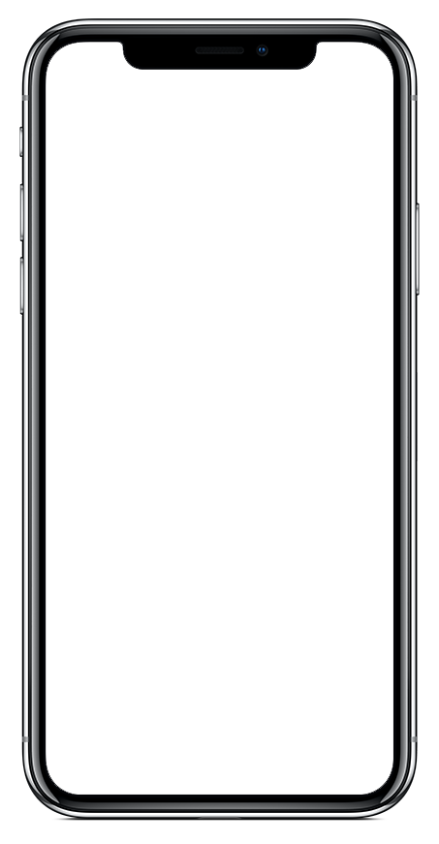


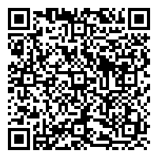

Standard Config
Safety Starts With You
Get the App for [COMPANY NAME]
Download “Vector LiveSafe” from Google Play or the App Store.
Register with your phone number & email.
Search for & select “[Company Name]” & then choose your community.
1
2
3
Scan Me
Notes:
TO UPDATE QR CODE: There are tons of options online for creating QR codes. One example is https://www.qr-code-generator.com/
Right-click the QR code. Select “Change Picture”
Locate the QR code you have generated for the organization you are creating a launch kit for. Select it.

Slide 2


Standard Config
SAFETY STARTS WITH YOU

Slide 3
Export Instructions
1) Once both side options have been finalized, move them above this slide.
2) Move all other card sides not being used below this slide.
3) Double-check spelling, QR codes, download instructions, etc.
4) Delete this slide and all slides that follow.
5) In the menu bar, click File >> Export >> PDF.

Slide 4
Profile Question
Safety Starts With You
Get the App for [COMPANY NAME]
Download “Vector LiveSafe” from Google Play or the App Store.
Register with your phone number & email.
Search for & select “[Company Name]” & then choose your community.
Answer any additional profile questions.
1
2
3
4
Scan Me
Notes:
TO UPDATE QR CODE: There are tons of options online for creating QR codes. One example is https://www.qr-code-generator.com/
Right-click the QR code. Select “Change Picture”
Locate the QR code you have generated for the organization you are creating a launch kit for. Select it.

Slide 5
Pin
Safety Starts With You
Get the App for [COMPANY NAME]
Download “Vector LiveSafe” from Google Play or the App Store.
Register with your phone number & email.
Search for & select “[Company Name]” & then choose your community.
When prompted, enter in pin “XXXX”.
1
2
3
4
Scan Me
Notes:
TO UPDATE QR CODE: There are tons of options online for creating QR codes. One example is https://www.qr-code-generator.com/
Right-click the QR code. Select “Change Picture”
Locate the QR code you have generated for the organization you are creating a launch kit for. Select it.

Slide 6
QR Code
Safety Starts With You
Get the App for [COMPANY NAME]
Scan the QR Code.
Download “Vector LiveSafe,” then input & verify your mobile phone number.
If prompted, search for your organization.
1
2
3
Scan Me
Notes:
TO UPDATE PHONE SCREEN: This is using an iPhone X for the base. Make sure you are replacing the app image with a screenshot taken from an iPhone X.
Right-click the iPhone X frame. Hover over “Send to Back” and select “Send Backward”. This will layer the app image above the phone frame so that you can easily select it and replace it with the updated image.
Right-click the app image. Select “Change Picture”.
Locate the screenshot you have already taken of the organization you are creating the launch kit for. Select it.
Right-click the updated screenshot you just dropped in. Hover over “Send to Back” and select “Send Backward”. This will layer the phone frame back on top of the app image.
TO UPDATE QR CODE: There are tons of options online for creating QR codes. One example is https://www.qr-code-generator.com/
Right-click the QR code. Select “Change Picture”
Locate the QR code you have generated for the organization you are creating a launch kit for. Select it.

Slide 7
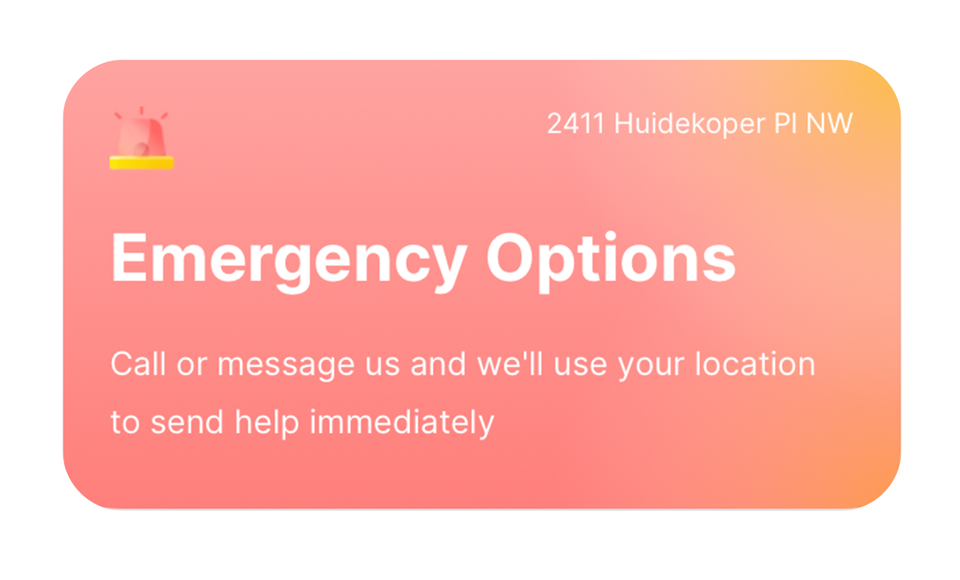
Old/Original Configuration
SAFETY STARTS WITH YOU

