Slide 1
Instructions For Customizing Templates
To save a slide as an image:
Click File >> Export
Choose “PNG” from the file format dropdown box.
Select “Save Every Slide” or “Save Current Slide Only”.
Select where to save it and click “Export”
Questions?
Reach out to support@livesafemobile.com.

Slide 2
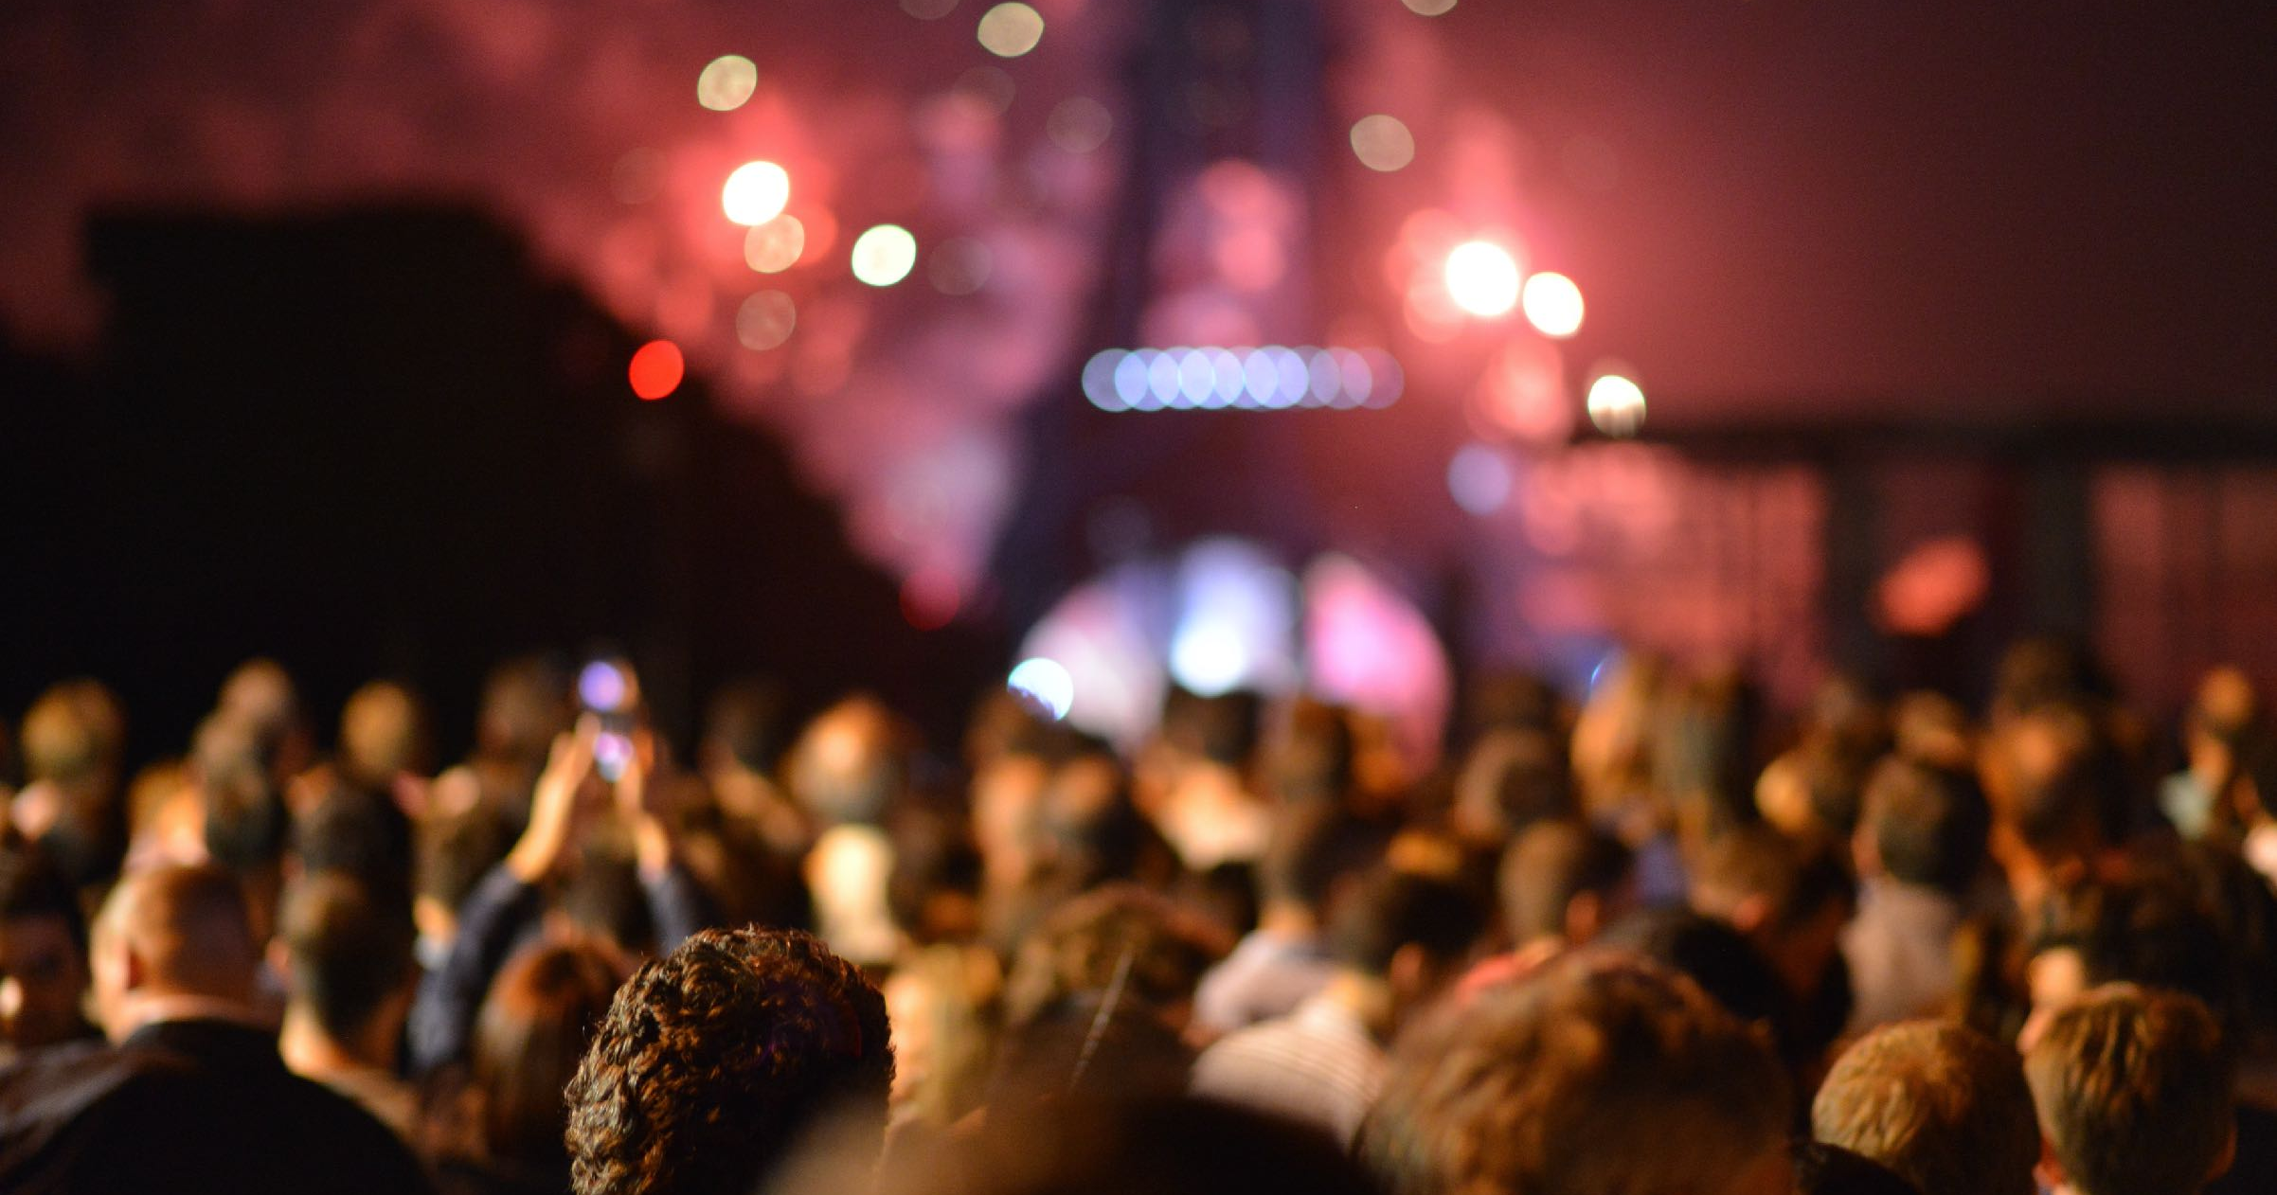
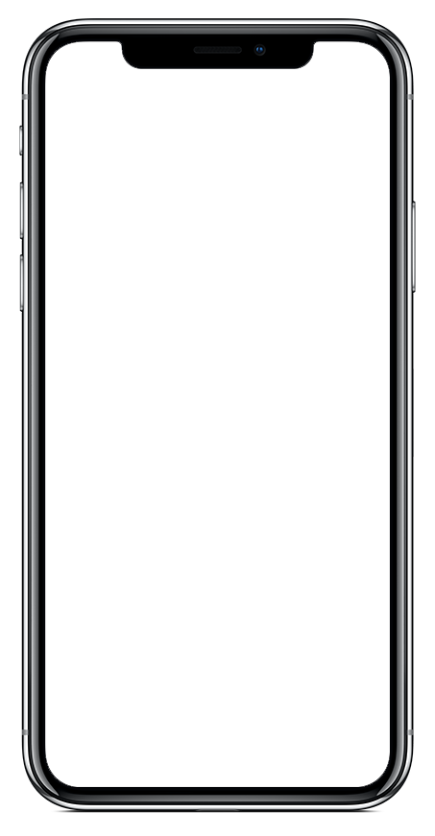
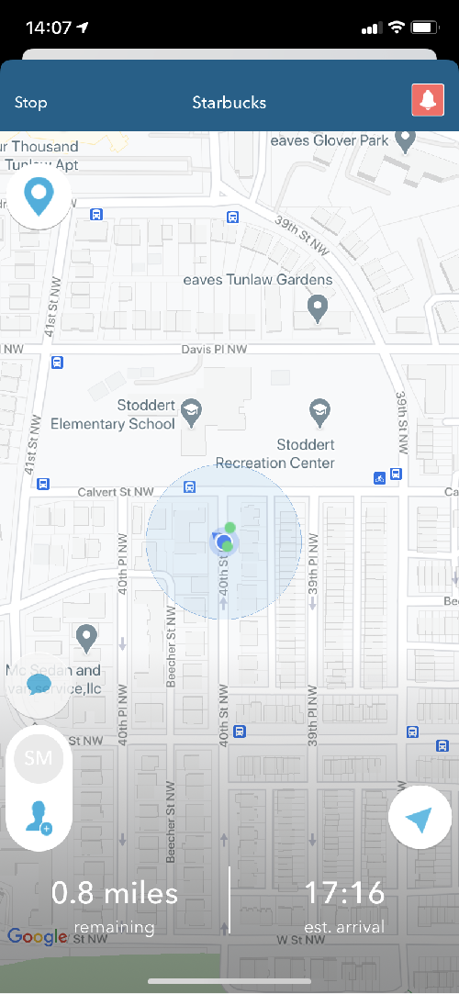
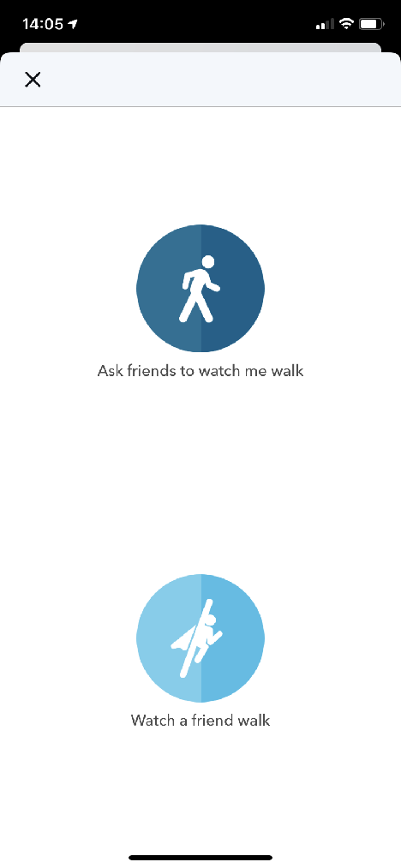

Out late for holiday festivities?
Remember to use the LiveSafe SafeWalk feature to virtually accompany friends and family to their destinations, whether they’re walking or driving

Slide 3
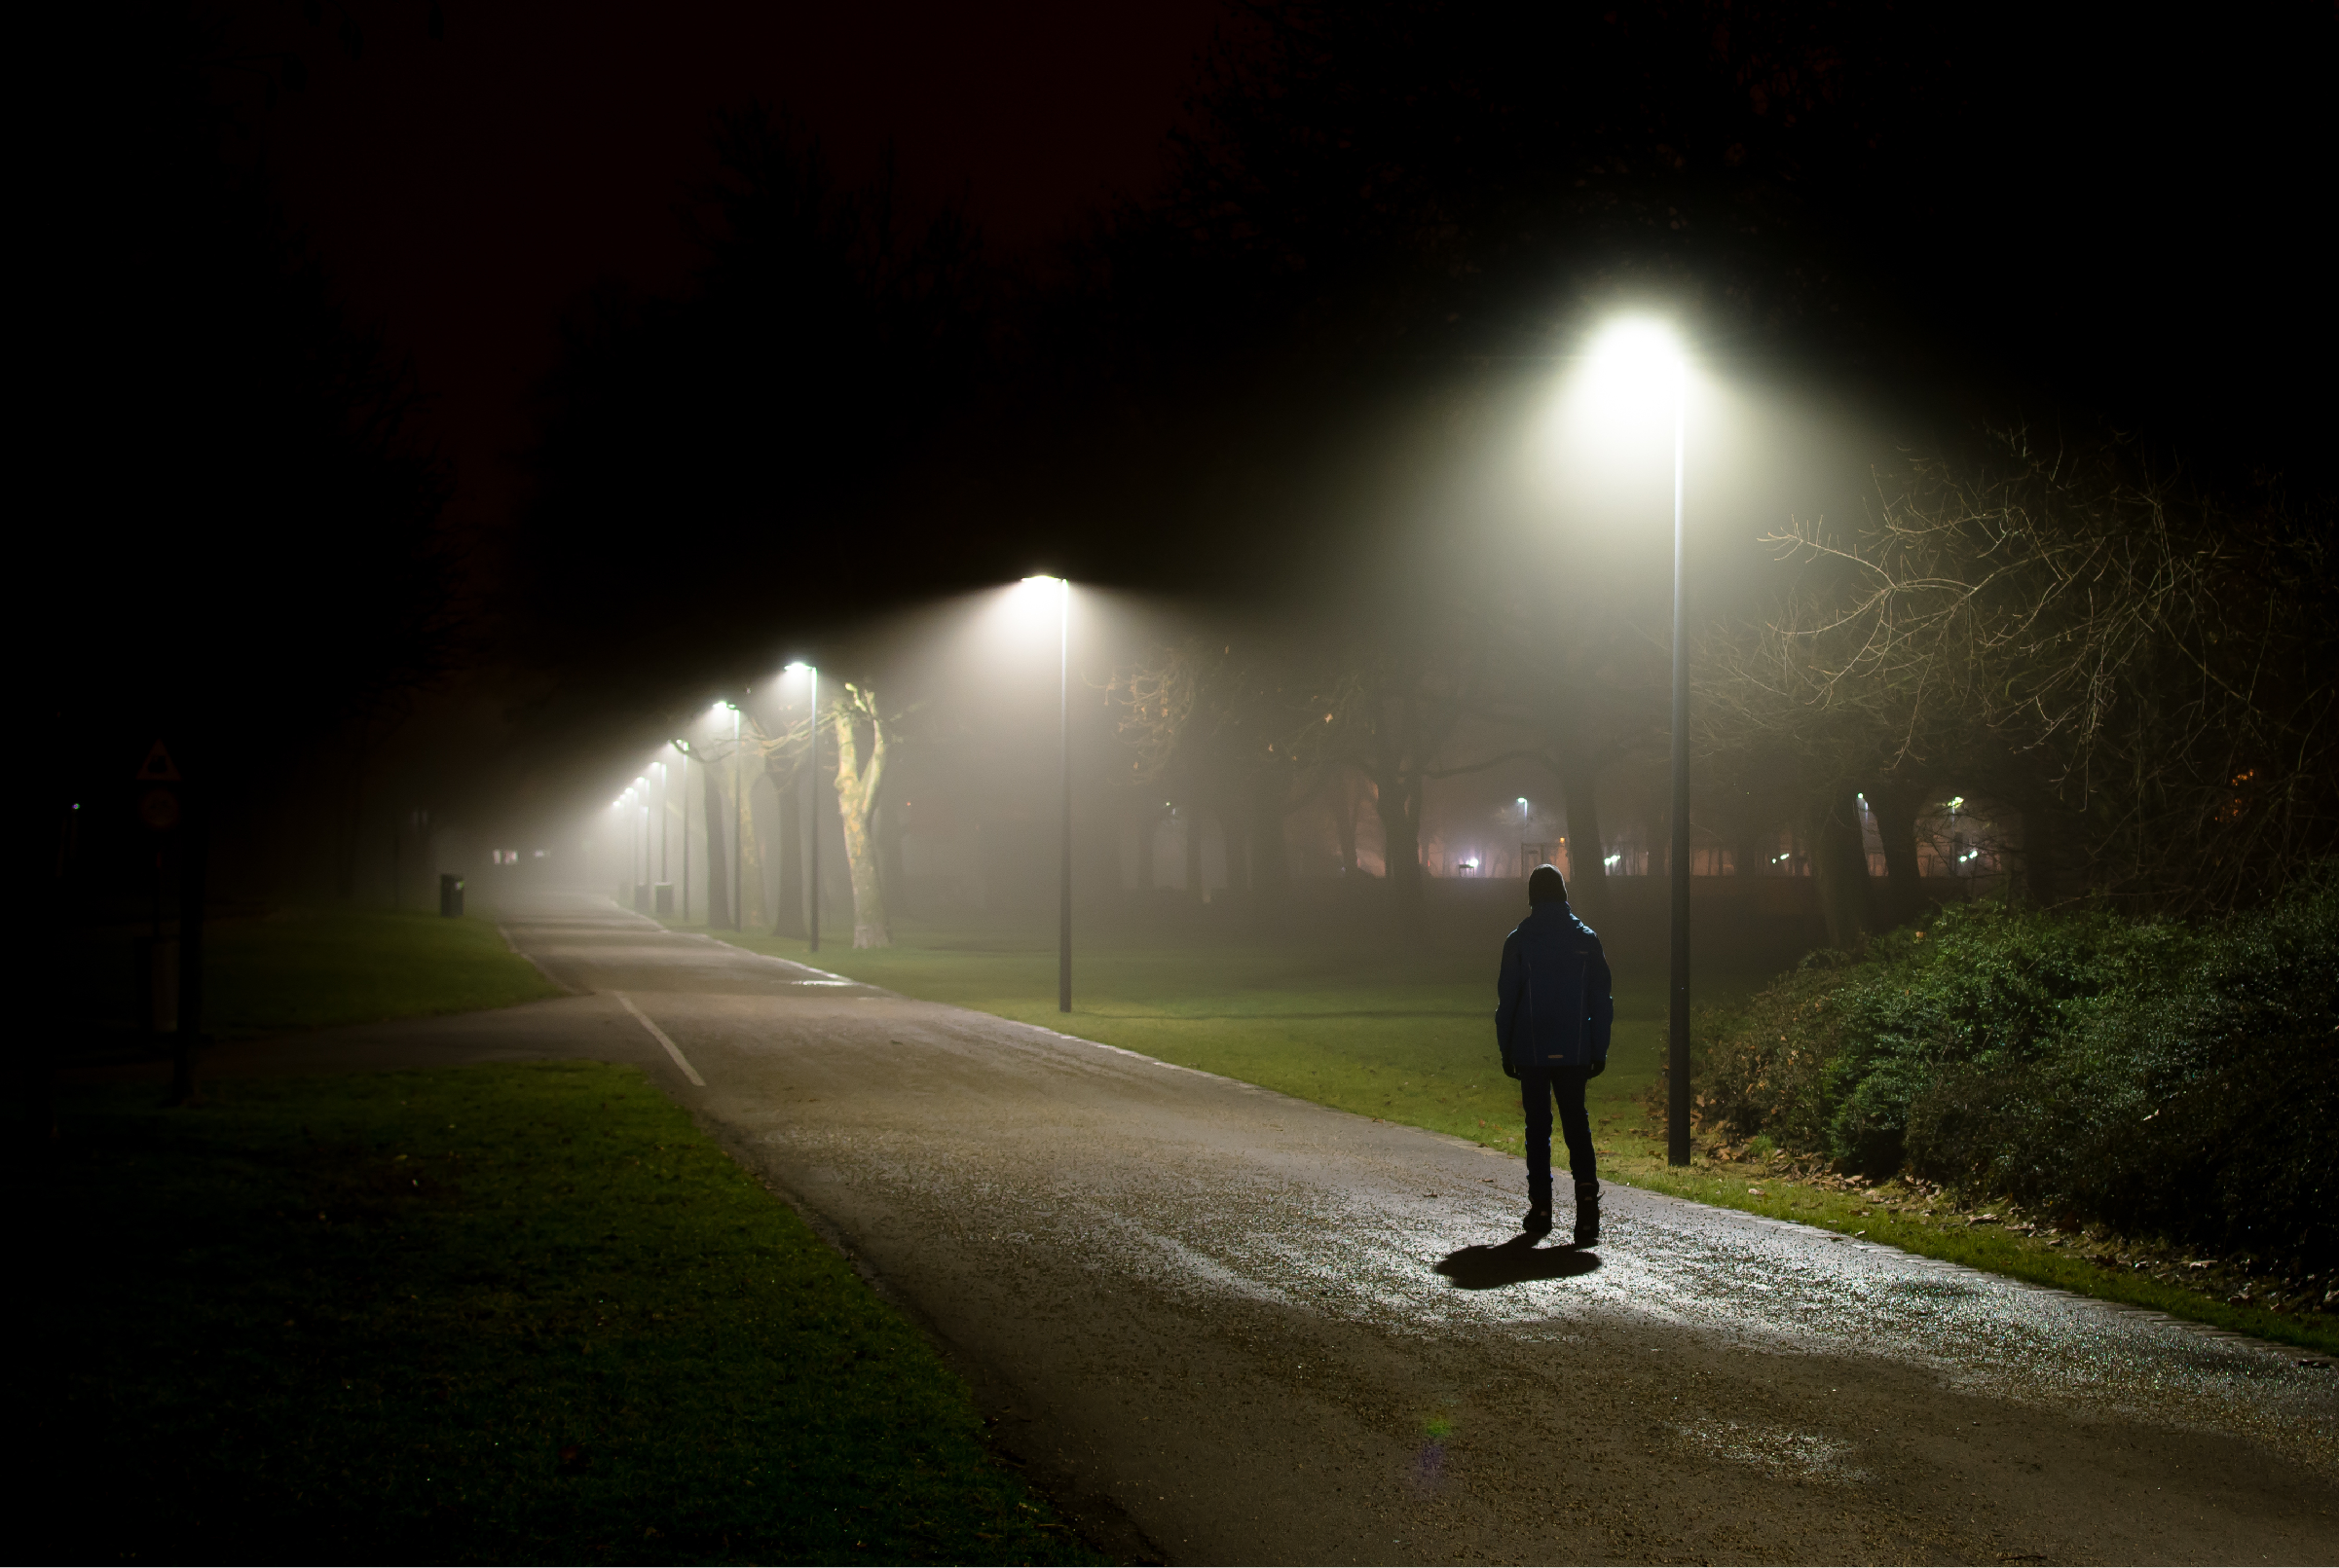
Up Late Studying?
You don’t have to walk home late at night alone.
Remember to use the LiveSafe SafeWalk feature to virtually accompany friends and family to their destinations.

Slide 4
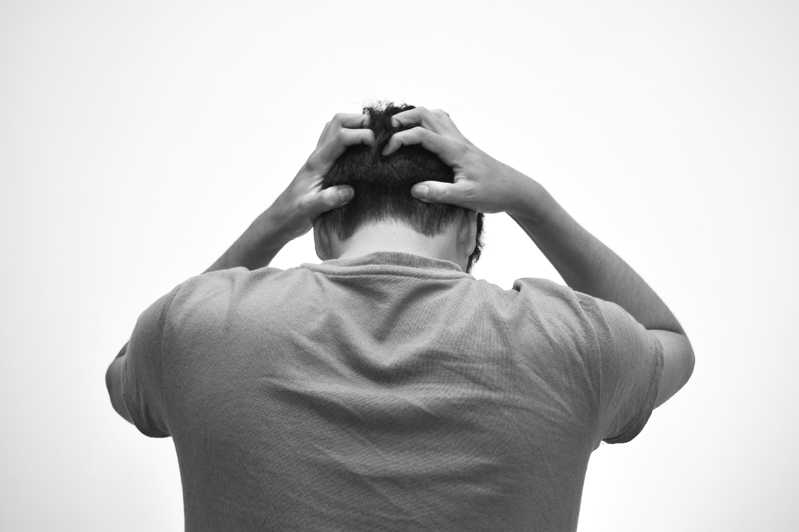
Stressed About
Finals?
Final exams and presentations can be stressful but remember, everything will be okay.
Use the LiveSafe app if you or someone you know needs help coping with end-of-semester stress.

Slide 5
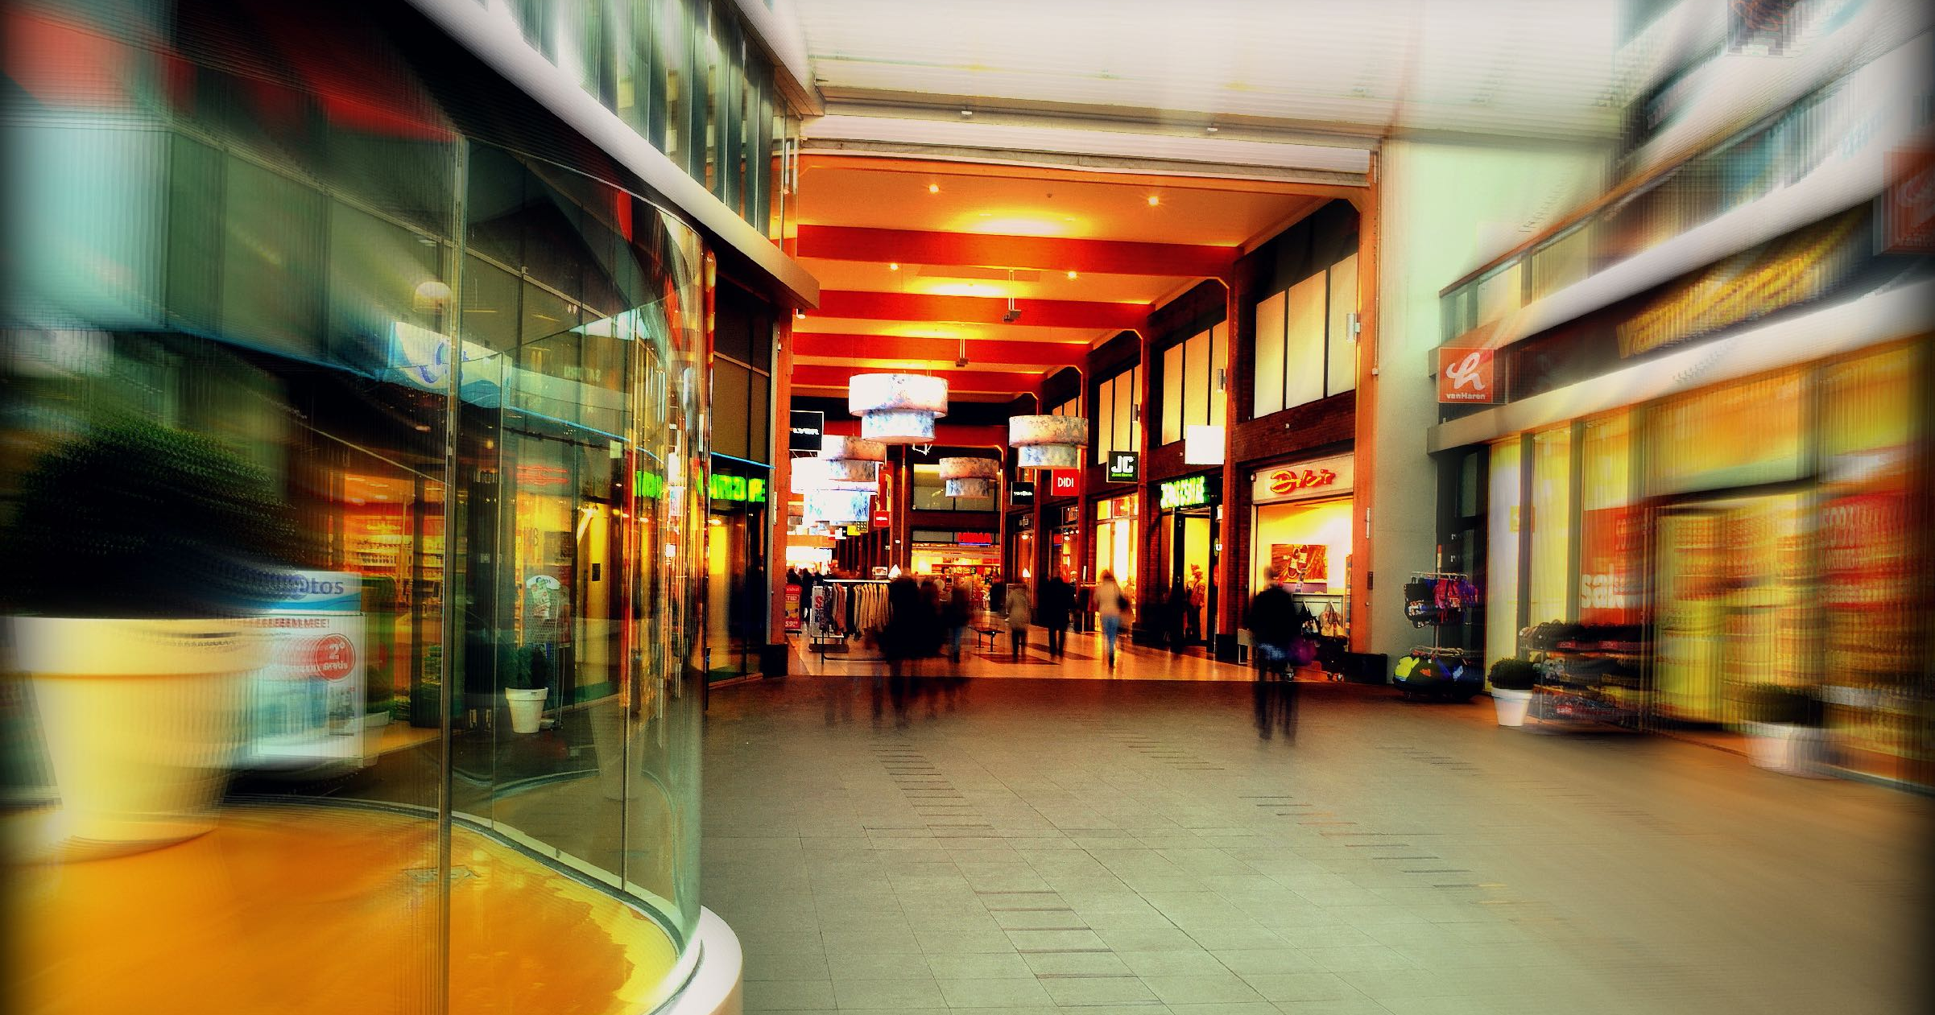

Theft is higher than usual during the holiday season
Take extra precautions and be aware of your surroundings. Lock your doors and secure your valuables and other belongings. Report suspicious activity and thefts to Security via the LiveSafe app.

Slide 6
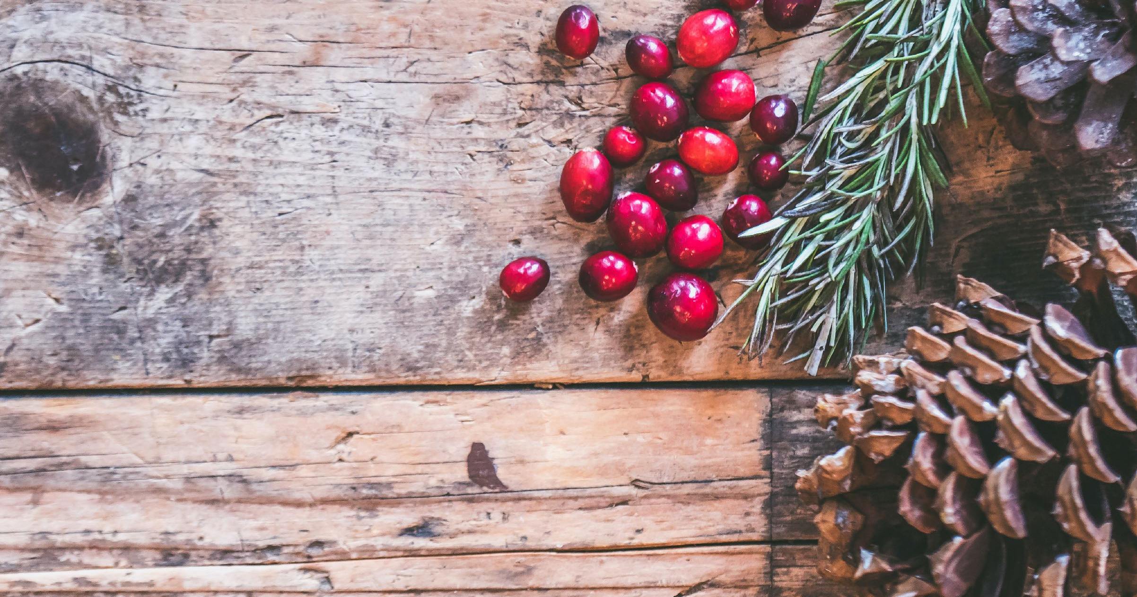

Happy
Holidays
From your partners in safety!

Slide 7



[ORG NAME] Security
has gone mobile
1
DOWNLOAD LIVESAFE
2
SHARE
INSIGHTS
3
GET HELP,
BE HELP
Notes:
Update Name:
Click text box with “[ORG NAME]”
Type in your organization’s name
To Change Background Color:
Click edge of blue box
Click “Shape Format” tab
Click “Shape Fill”
Choose preset color or for a custom color, select ”More Fill Colors” and enter in hex code

