Slide 1
Instructions For
Customizing Templates
To save a slide as a PDF, ready to print:
Click File >> Export
Choose “PDF” from the file format dropdown box
Select “Save Current Slide Only”
Select where to save it and click “Export”
Questions?
Reach out to support.livesafe@vectorsolutions.com.

Slide 2


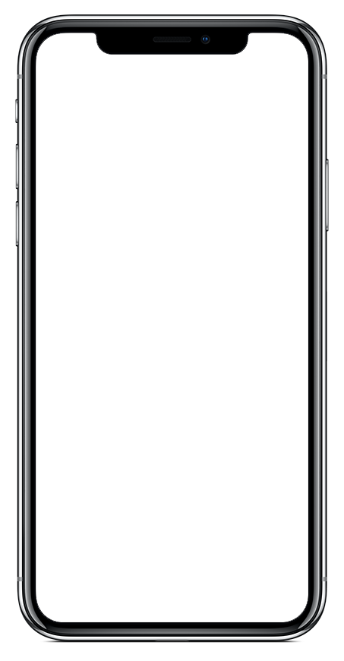
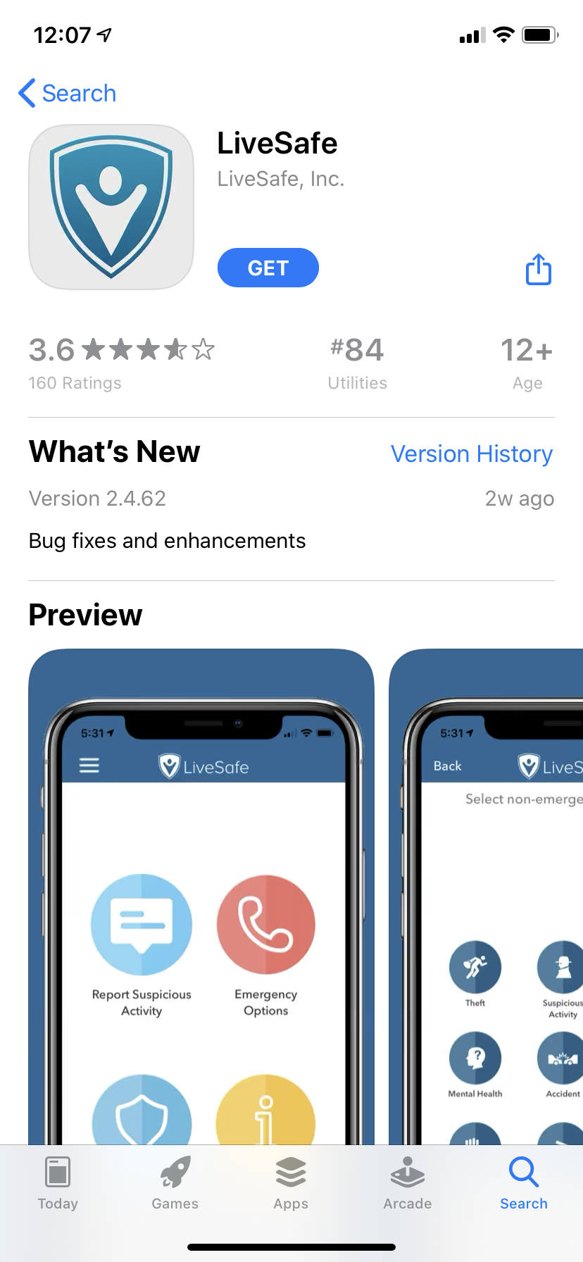
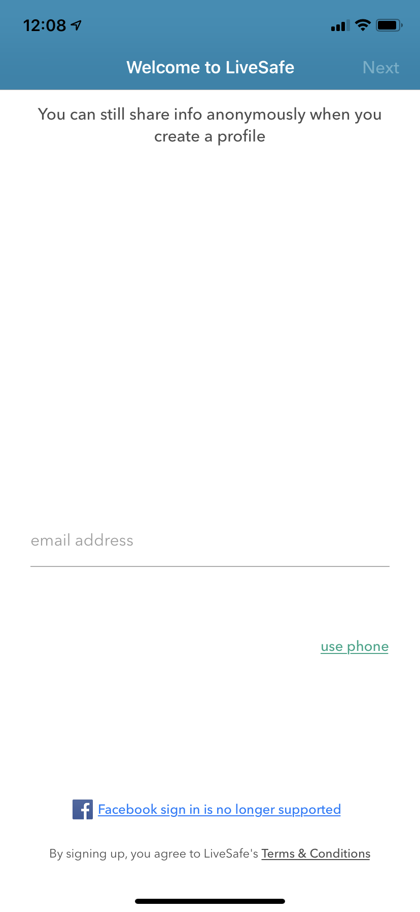
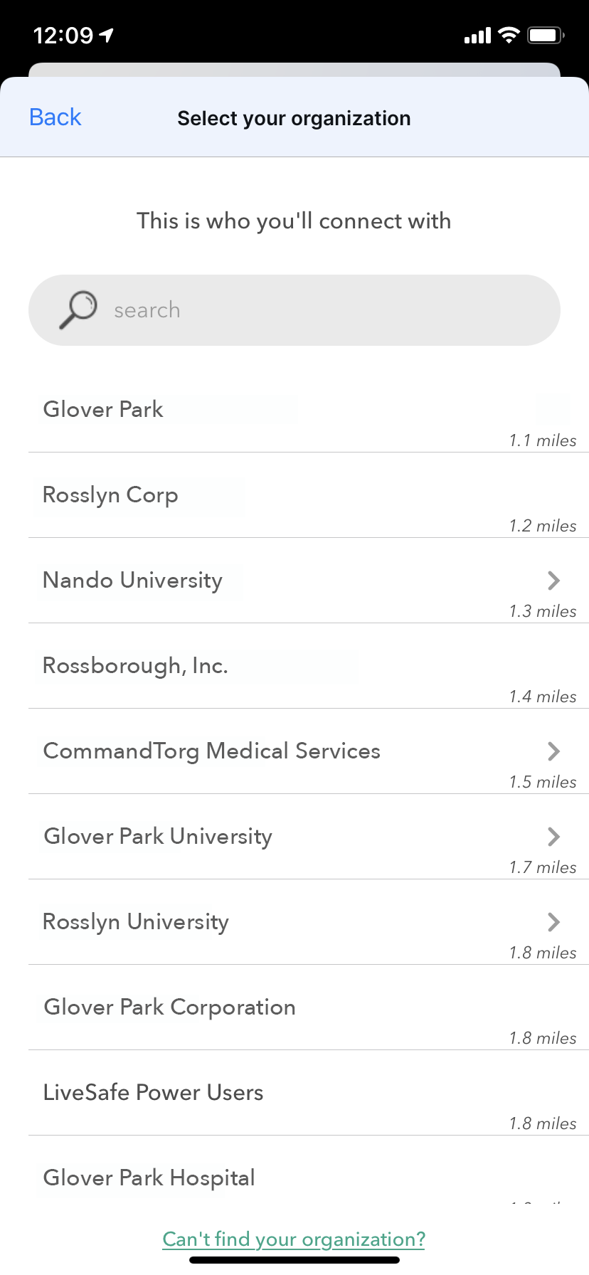
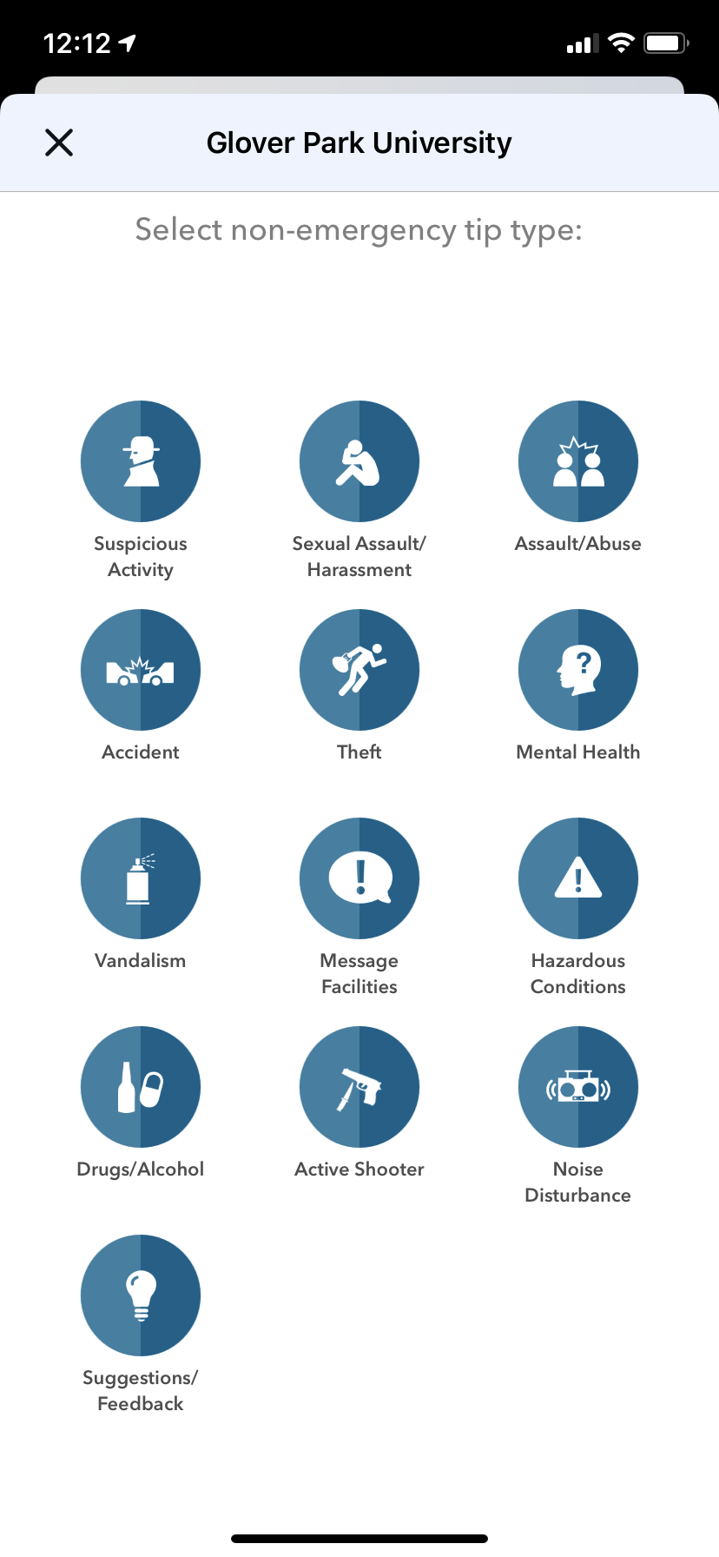
Download LiveSafe &
Connect with Security
1
2
3
4
APP STORE
Download “LiveSafe” from Google Play or the App Store
PROFILE
Register with your mobile number & university email
CONNECT
Search for & select your university
SHARE
Hazardous conditions? Suspicious Activity? Share what you see
Notes:
To Replace “Your University” With The Name Of Your School:
Click “Edit” from the menu bar
Select “Find” and then “Replace” from the dropdown
Under ‘Find What:’ type in “your organization”
Under ‘Replace With:’ type in the name of your company and click “Replace All”
To Replace the “Logo Placeholder” With Your Logo In The Header:
Right-click the middle of the “fake logo” image, to the right of the Live Safe logo
Select “Change Picture”
Select the light/white version of your organization’s logo (to be used on darker backgrounds). Make sure you are selecting a PNG for the file type.
To Replace Phone Screen With Your Configuration:
Right-click the middle of the home screen image
Select “Change Picture”
Select an image of your home screen configuration from your computer. Ideally, the screenshot was taken using an iPhone X or later. If you don’t have access to an iPhone X, reach out to support@livesafemobile.com.
To Change Color For Footer Banners:
Click edge of blue box
Click “Shape Format” tab
Click “Shape Fill”
Choose a preset color or to select a custom color, click ”More Fill Colors” and enter in hex code

Slide 3

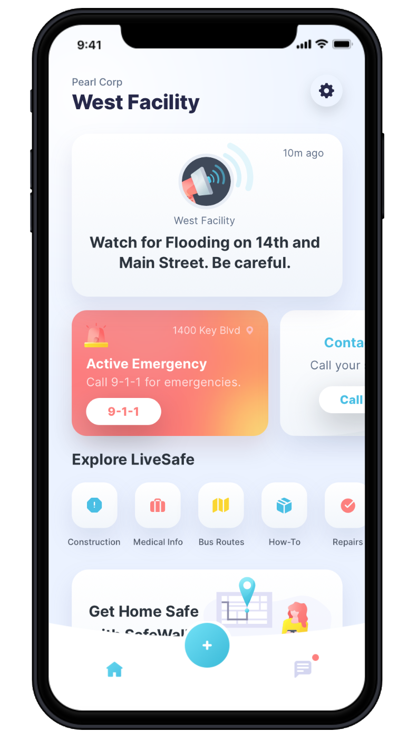
Graphical Style
Share Info with Security
See something out of place? Let us know. Anonymously if you choose
With the SafeWalk feature, invite up to three contacts to digitally accompany you on a real-time map
Access helpful resources
Get LiveSafe
Download “LiveSafe” from the Google Play or App Store
Search for & select your university
1
2
3
1
2
Notes:
To Replace “Your University” With The Name Of Your School:
Click “Edit” from the menu bar
Select “Find” and then “Replace” from the dropdown
Under ‘Find What:’ type in “your organization”
Under ‘Replace With:’ type in the name of your company and click “Replace All”
To Replace the “Logo Placeholder” With Your Logo In The Header:
Right-click the middle of the “fake logo” image, to the right of the Live Safe logo
Select “Change Picture”
Select the light/white version of your organization’s logo (to be used on darker backgrounds). Make sure you are selecting a PNG for the file type.
To Replace Phone Screen With Your Configuration:
Right-click the middle of the home screen image
Select “Change Picture”
Select an image of your home screen configuration from your computer. Ideally, the screenshot was taken using an iPhone X or later. If you don’t have access to an iPhone X, reach out to support@livesafemobile.com.
To Change Color For Footer Banners:
Click edge of blue box
Click “Shape Format” tab
Click “Shape Fill”
Choose a preset color or to select a custom color, click ”More Fill Colors” and enter in hex code

Slide 4
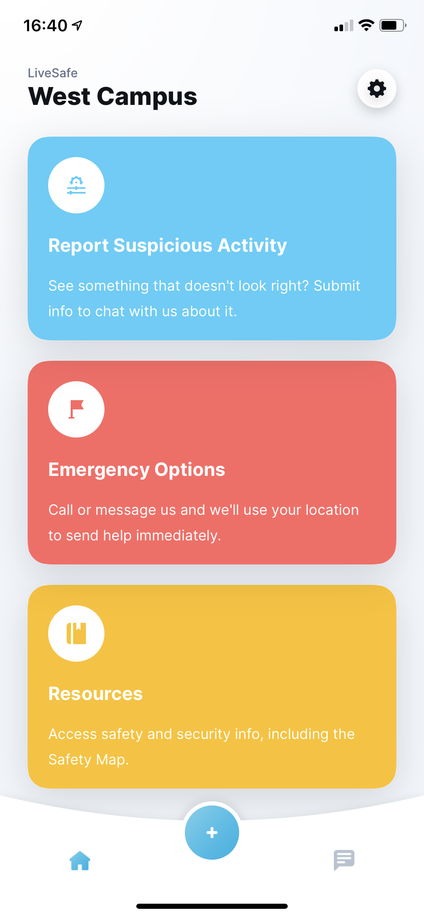
Standard Style
Share Info with Security
See something out of place? Let us know. Anonymously if you choose
With the SafeWalk feature, invite up to three contacts to digitally accompany you on a real-time map
Access helpful resources
Get LiveSafe
Download “LiveSafe” from the Google Play or App Store
Search for & select your university
1
2
3
1
2
Notes:
To Replace “Your University” With The Name Of Your School:
Click “Edit” from the menu bar
Select “Find” and then “Replace” from the dropdown
Under ‘Find What:’ type in “your organization”
Under ‘Replace With:’ type in the name of your company and click “Replace All”
To Replace the “Logo Placeholder” With Your Logo In The Header:
Right-click the middle of the “fake logo” image, to the right of the Live Safe logo
Select “Change Picture”
Select the light/white version of your organization’s logo (to be used on darker backgrounds). Make sure you are selecting a PNG for the file type.
To Replace Phone Screen With Your Configuration:
Right-click the middle of the home screen image
Select “Change Picture”
Select an image of your home screen configuration from your computer. Ideally, the screenshot was taken using an iPhone X or later. If you don’t have access to an iPhone X, reach out to support@livesafemobile.com.
To Change Color For Footer Banners:
Click edge of blue box
Click “Shape Format” tab
Click “Shape Fill”
Choose a preset color or to select a custom color, click ”More Fill Colors” and enter in hex code

