Slide 1

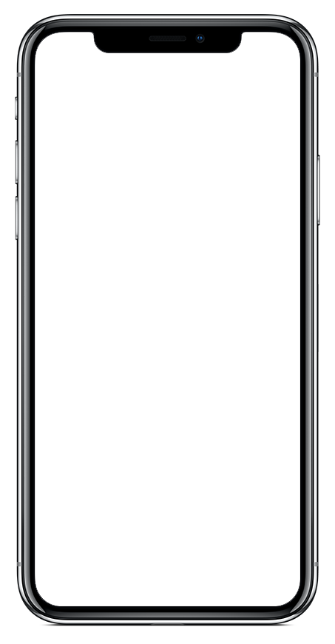

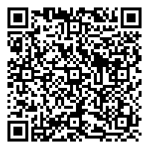

Community-Sourced Risk Intelligence
Request Help
Communicate with local emergency services and your organization’s safety officials – no matter where you are.
Your Company Name
Customize Title
Settings
Access profile settings, manage your organizations, and get app help.
Glover Park Corp
Access Information and Emergency Procedures
View important information from your organization, like emergency procedures and community resources.
SafeWalk
Invite friends to virtually walk you to your destination.
Tab Navigation: Home
See an overview of LiveSafe resources and updates from your organization.
Tab Navigation: Activity
Access broadcast messages, check-ins, and chat conversations.
Submit Tips to Safety & Security
When you see something suspicious, share that info with your organization’s safety and security team.
Get the Vector LiveSafe App
Download Vector LiveSafe from the App Store or Google Play or using the QR code
Register and complete your profile
Search for and select your organization
Notes:
TO UPDATE PHONE SCREEN: This is using an iPhone X for the base. Make sure you are replacing the app image with a screenshot taken from an iPhone X.
Right-click the iPhone X frame. Hover over “Send to Back” and select “Send Backward”. This will layer the app image above the phone frame so that you can easily select it and replace it with the updated image.
Right-click the app image. Select “Change Picture”.
Locate the screenshot you have already taken of the organization you are creating the launch kit for. Select it.
Right-click the updated screenshot you just dropped in. Hover over “Send to Back” and select “Send Backward”. This will layer the phone frame back on top of the app image.

Slide 2
Student-Sourced Risk Intelligence
Request Help
Communicate with local emergency services and your school’s safety officials – no matter where you are.
Your Company Name
Customize Title
Settings
Access profile settings, manage your community, and get app help.
Glover Park Corp
Access Information and Emergency Procedures
View important information from your school, like emergency procedures and community resources.
SafeWalk
Invite friends to virtually walk you to your destination.
Tab Navigation: Home
See an overview of LiveSafe resources and updates from your organization.
Tab Navigation: Activity
Access broadcast messages, check-ins, and chat conversations.
Submit Tips to Safety & Security
When you see something suspicious, share that info with your school’s safety and security team.
Get the Vector LiveSafe App
Download Vector LiveSafe from the App Store or Google Play or using the QR code
Register and complete your profile
Search for and select your School
Notes:
TO UPDATE PHONE SCREEN: This is using an iPhone X for the base. Make sure you are replacing the app image with a screenshot taken from an iPhone X.
Right-click the iPhone X frame. Hover over “Send to Back” and select “Send Backward”. This will layer the app image above the phone frame so that you can easily select it and replace it with the updated image.
Right-click the app image. Select “Change Picture”.
Locate the screenshot you have already taken of the organization you are creating the launch kit for. Select it.
Right-click the updated screenshot you just dropped in. Hover over “Send to Back” and select “Send Backward”. This will layer the phone frame back on top of the app image.

Slide 3
Fan-Sourced Risk Intelligence
Request Help
Communicate with local emergency services and your organization’s safety officials – no matter where you are.
Your Company Name
Customize Title
Settings
Access profile settings, manage your organizations, and get app help.
Glover Park Corp
Access Information and Emergency Procedures
View important information from your organization, like emergency procedures and community resources.
SafeWalk
Invite friends to virtually walk you to your destination.
Tab Navigation: Home
See an overview of LiveSafe resources and updates from your organization.
Tab Navigation: Activity
Access broadcast messages, check-ins, and chat conversations.
Submit Tips to Safety & Security
When you see something suspicious, share that info with your organization’s safety and security team.
Get the Vector LiveSafe App
Download Vector LiveSafe from the App Store or Google Play or using the QR code
Register and complete your profile
Search for and select your organization
Notes:
TO UPDATE PHONE SCREEN: This is using an iPhone X for the base. Make sure you are replacing the app image with a screenshot taken from an iPhone X.
Right-click the iPhone X frame. Hover over “Send to Back” and select “Send Backward”. This will layer the app image above the phone frame so that you can easily select it and replace it with the updated image.
Right-click the app image. Select “Change Picture”.
Locate the screenshot you have already taken of the organization you are creating the launch kit for. Select it.
Right-click the updated screenshot you just dropped in. Hover over “Send to Back” and select “Send Backward”. This will layer the phone frame back on top of the app image.

Slide 4
Fan-Sourced Risk Intelligence
Request Help
Communicate with local emergency services and your organization’s safety officials – no matter where you are.
Your Company Name
Customize Title
Settings
Access profile settings, manage your organizations, and get app help.
Glover Park Corp
Access Information and Emergency Procedures
View important information from your organization, like emergency procedures and community resources.
SafeWalk
Invite friends to virtually walk you to your destination.
Tab Navigation: Home
See an overview of LiveSafe resources and updates from your organization.
Tab Navigation: Activity
Access broadcast messages, check-ins, and chat conversations.
Submit Tips to Safety & Security
When you see something suspicious, share that info with your organization’s safety and security team.
Get the Vector LiveSafe App
Download Vector LiveSafe from the App Store or Google Play or using the QR code
Register and complete your profile
Search for and select your organization
Notes:
TO UPDATE PHONE SCREEN: This is using an iPhone X for the base. Make sure you are replacing the app image with a screenshot taken from an iPhone X.
Right-click the iPhone X frame. Hover over “Send to Back” and select “Send Backward”. This will layer the app image above the phone frame so that you can easily select it and replace it with the updated image.
Right-click the app image. Select “Change Picture”.
Locate the screenshot you have already taken of the organization you are creating the launch kit for. Select it.
Right-click the updated screenshot you just dropped in. Hover over “Send to Back” and select “Send Backward”. This will layer the phone frame back on top of the app image.

