Slide 1
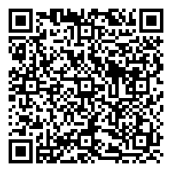

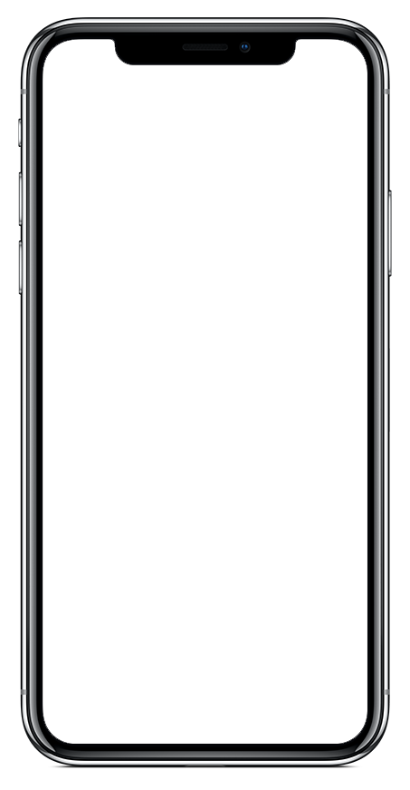


Community-Sourced Risk Intelligence
Request Help
Communicate with local emergency services and your organization’s safety officials – no matter where you are.
Glover Park Corp
Settings
Access profile settings, manage your organizations, and get app help.
SafeWalk
Invite friends to virtually walk you to your destination.
Access Information and Emergency Procedures
View important information from your organization, like emergency procedures and community resources.
Tab Navigation: Home
See an overview of LiveSafe resources and updates from your organization.
Tab Navigation: Activity
Access broadcast messages, check-ins, and chat conversations.
Submit Tips to Safety & Security
When you see something suspicious, share that info with your organization’s safety and security team.
Get LiveSafe
Download “LiveSafe” from the App Store or Google Play. Register and fill out your profile. Search for & select our organization. You’re set!
Notes:
TO UPDATE PHONE SCREEN: This is using an iPhone X for the base. Make sure you are replacing the app image with a screenshot taken from an iPhone X.
Right-click the iPhone X frame. Hover over “Send to Back” and select “Send Backward”. This will layer the app image above the phone frame so that you can easily select it and replace it with the updated image.
Right-click the app image. Select “Change Picture”.
Locate the screenshot you have already taken of the organization you are creating the launch kit for. Select it.
Right-click the updated screenshot you just dropped in. Hover over “Send to Back” and select “Send Backward”. This will layer the phone frame back on top of the app image.

Slide 2

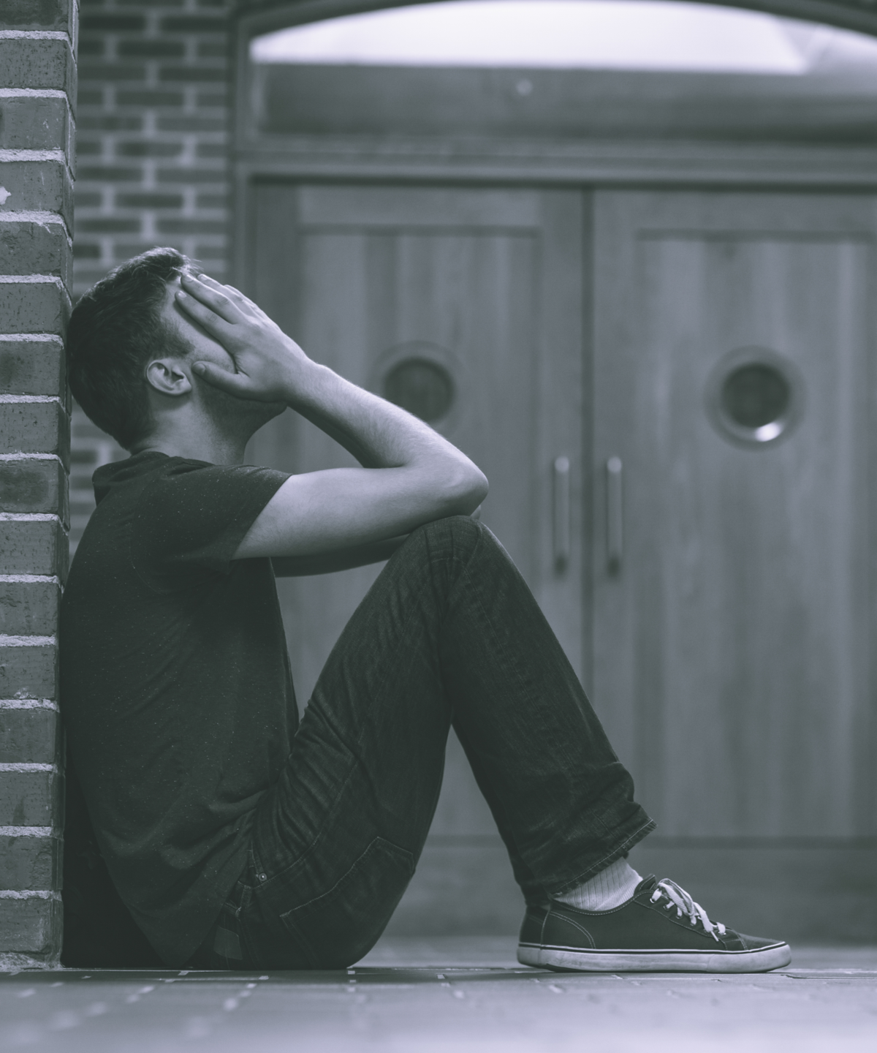
It’s Not Your Fault
The victim of a sexual assault is never to blame.
for
More than 95% of sexual assaults are not reported.
Victims of sexual assault may suffer from anxiety, depression, PTSD, or other challenges.
Do not suffer alone. There are people and resources to help you.
Use the LiveSafe Mobile App to report any sexual assaults or other safety and security issues, anonymously if you choose. The LiveSafe App can help you get the support and resources that you or someone else may need.
Get the App:
Download LiveSafe from the App Store or Google Play or using the QR code
Register and complete your profile
Search for and select your organization
Notes:
To Replace “Fake Logo” With Your Organization’s Logo In The Header:
Right-click the middle of the “fake logo” image, to the right of the Live Safe logo
Select “Change Picture”
Select the light/white version of your organization’s logo (to be used on darker backgrounds). Make sure you are selecting a PNG for the file type.
To Replace Phone Screen With Your Organization’s Configuration:
Right-click the middle of the home screen image
Select “Change Picture”
Select an image of your home screen configuration from your computer. Ideally, the screenshot was taken using an iPhone 6. If you don’t have access to an iPhone 6, reach out to support@livesafemobile.com.
To Change Color For Header and Footer Banners:
Click edge of blue box
Click “Shape Format” tab
Click “Shape Fill”
Choose a preset color or to select a custom color, click ”More Fill Colors” and enter in hex code

Slide 3

Consent Means Yes
Consenting to sexual activity means you are voluntarily affirming you want to engage in sexual activity free of force.
for
If you or someone you know is being pressured to engage in sexual activity or is a victim of a non-consensual sexual encounter, report it to Campus Security or the local police.
Use the LiveSafe Mobile App to report any sexual assaults, anonymously if you choose. The LiveSafe App can help you or someone you know get the support and resources needed.
Get the App:
Download LiveSafe from the App Store or Google Play or using the QR code
Register and complete your profile
Search for and select your organization
Notes:
To Replace “Fake Logo” With Your Organization’s Logo In The Header:
Right-click the middle of the “fake logo” image, to the right of the Live Safe logo
Select “Change Picture”
Select the light/white version of your organization’s logo (to be used on darker backgrounds). Make sure you are selecting a PNG for the file type.
To Replace Phone Screen With Your Organization’s Configuration:
Right-click the middle of the home screen image
Select “Change Picture”
Select an image of your home screen configuration from your computer. Ideally, the screenshot was taken using an iPhone 6. If you don’t have access to an iPhone 6, reach out to support@livesafemobile.com.
To Change Color For Header and Footer Banners:
Click edge of blue box
Click “Shape Format” tab
Click “Shape Fill”
Choose a preset color or to select a custom color, click ”More Fill Colors” and enter in hex code

Slide 4

Enough is Enough
Take action to prevent sexual assaults on your campus.
for
Sexual assault is not love – it is a crime. Stand up for the victims and speak out against sexual assault and harassment.
Use the LiveSafe Mobile App to report any sexual assaults or sexual harassment, anonymously if you choose. LiveSafe can help make your campus a safer place to work, learn, and live.
Get the App:
Download LiveSafe from the App Store or Google Play or using the QR code
Register and complete your profile
Search for and select your organization
Notes:
To Replace “Fake Logo” With Your Organization’s Logo In The Header:
Right-click the middle of the “fake logo” image, to the right of the Live Safe logo
Select “Change Picture”
Select the light/white version of your organization’s logo (to be used on darker backgrounds). Make sure you are selecting a PNG for the file type.
To Replace Phone Screen With Your Organization’s Configuration:
Right-click the middle of the home screen image
Select “Change Picture”
Select an image of your home screen configuration from your computer. Ideally, the screenshot was taken using an iPhone 6. If you don’t have access to an iPhone 6, reach out to support@livesafemobile.com.
To Change Color For Header and Footer Banners:
Click edge of blue box
Click “Shape Format” tab
Click “Shape Fill”
Choose a preset color or to select a custom color, click ”More Fill Colors” and enter in hex code

Slide 5
Instructions for
Customizing Templates
To save a slide as an image:
Click File >> Export
Choose “PNG” from the file format dropdown box
Select “Save Current Slide Only”
Select where to save it and click “Export”
Questions?
Reach out to support.livesafe@vectorsolutions.com.

