Slide 1
Instructions for
Customizing Templates
To save a slide as an image:
Click File >> Export
Choose “PNG” from the file format dropdown
Select “Save Current Slide Only”
Select where to save it and click “Export”
Questions?
Reach out to support@livesafemobile.com.

Slide 2
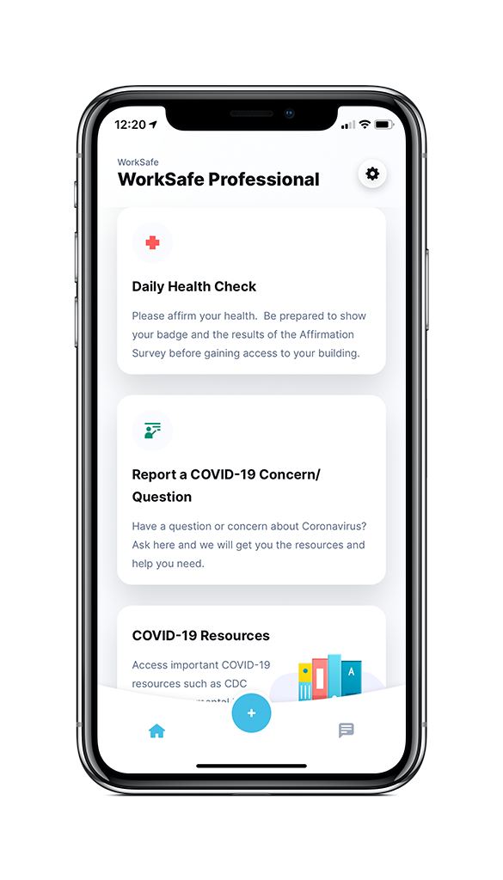
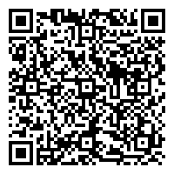
Start Using WorkSafe Today! You can access WorkSafe by downloading the LiveSafe Mobile App, a free resource for your community!
for
Submit COVID-related Questions and Concerns
If you want to report a health concern or ask a COVID-related question, share it with your organization’s leadership. You can submit text, images, and video recordings, anonymously if desired, and receive a response in real-time.
Report Your
Health Status
Fill out the Daily Health Check Survey to let your employer know if you are feeling healthy and able to come to work or if you are not feeling well and are not able to come in.
Get Instant Updates
Receive broadcast messages from your company to stay informed of business operations and protocol.
Access COVIDI Information and Policies
Instantly access organization-specific COVID information, emergency procedures, and local resources.
Get the App:
Download LiveSafe from the App Store or Google Play or using the QR code
Register and complete your profile
Search for and select your organization
Notes:
To Replace “Fake Logo” With Your Organization’s Logo In The Header:
Right-click the middle of the “fake logo” image, to the right of the LiveSafe logo
Select “Change Picture”
Select the light/white version of your organization’s logo (to be used on darker backgrounds). Make sure you are selecting a PNG for the file type.
To Replace Phone Screen With Your Organization’s Configuration:
Right-click the middle of the home screen image
Select “Change Picture”
Select an image of your home screen configuration from your computer. Ideally, the screenshot was taken using an iPhone 6. If you don’t have access to an iPhone 6, reach out to support@livesafemobile.com.
To Change Color For Header and Footer Banners:
Click edge of blue box
Click “Shape Format” tab
Click “Shape Fill”
Choose a preset color or to select a custom color, click ”More Fill Colors” and enter in hex code

