Slide 1
Instructions for
Customizing Templates
To save a slide as an image:
Click File >> Export
Choose “PNG” from the file format dropdown
Select “Save Current Slide Only”
Select where to save it and click “Export”
Questions?
Reach out to support@livesafemobile.com.

Slide 2


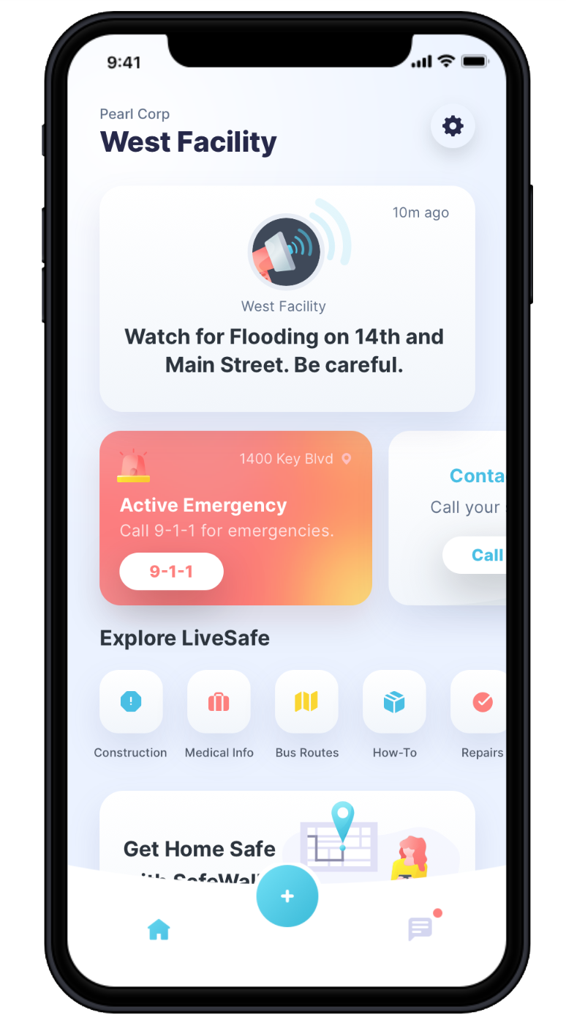

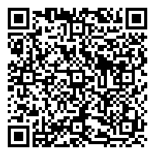

How to Use LiveSafe
LiveSafe, a free resource for your community, allows you to easily access safety resources and report concerns. Whether you are are taking classes from home or in person, LiveSafe is here to keep you safe.
for
Get Instant Updates
Stay informed by reading any broadcast messages sent to you by your school.
Settings
Access profile settings, manage your organizations, and get app help.
Access Information and Emergency Procedures
Easily access important information, emergency procedures, and local resources, as well as your school’s Safety Map. For students who remained on campus or faculty and students that live off campus, use this feature to see all nearby safety locations like police stations or hospitals.
Request Help
Emergencies can happen anywhere at any time. Request help in an emergency and access the emergency numbers specific to your school.
Share Info with Safety & Security
Share any safety concerns with your school’s public safety officials. Even while away from campus, you can submit text, files, or video, anonymously if desired.
SafeWalk
SafeWalk will alert your contacts (friends or family) if you do not arrive safely while walking or driving. You can even let them watch you commute in real time via GPS.
Get the App:
Download LiveSafe from the App Store or Google Play or using the QR code
Register and complete your profile
Search for and select your organization
Notes:
To Replace “Fake Logo” With Your Organization’s Logo In The Header:
Right-click the middle of the “fake logo” image, to the right of the Live Safe logo
Select “Change Picture”
Select the light/white version of your organization’s logo (to be used on darker backgrounds). Make sure you are selecting a PNG for the file type.
To Replace Phone Screen With Your Organization’s Configuration:
Right-click the middle of the home screen image
Select “Change Picture”
Select an image of your home screen configuration from your computer. Ideally, the screenshot was taken using an iPhone 6. If you don’t have access to an iPhone 6, reach out to support@livesafemobile.com.
To Change Color For Header and Footer Banners:
Click edge of blue box
Click “Shape Format” tab
Click “Shape Fill”
Choose a preset color or to select a custom color, click ”More Fill Colors” and enter in hex code

