Slide 1
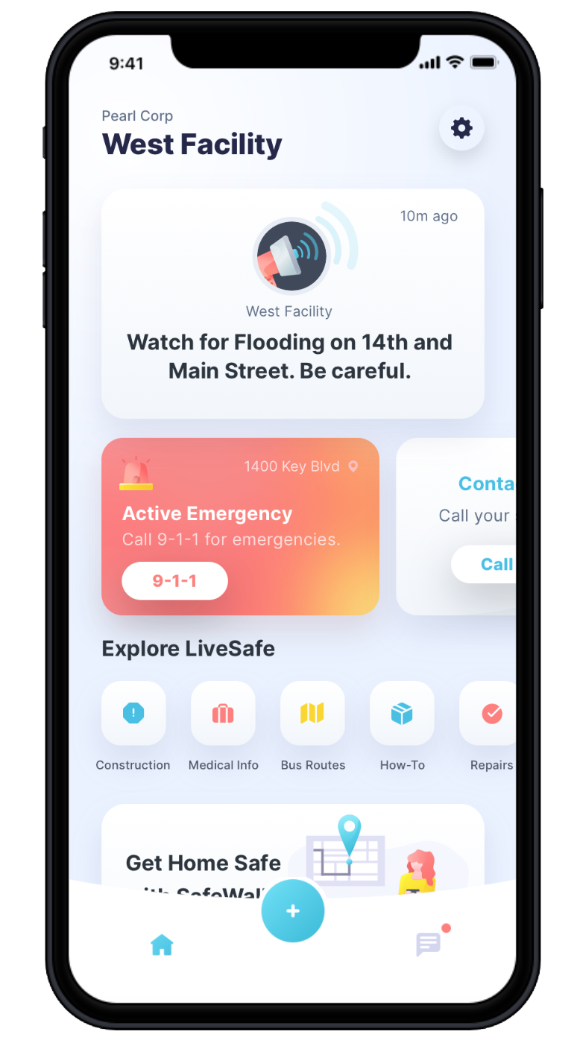
Employee-Sourced Risk Intelligence
Get Instant Updates
Broadcast messages are displayed at the top of the home screen for quick access to information.
Settings
Access profile settings, manage your organizations, and get app help.
Request Help
Communicate with local emergency services and your organization’s safety officials – no matter where you are.
Access Information and Emergency Procedures
View important information from your organization, like emergency procedures and community resources.
SafeWalk
Invite friends to virtually walk you to your destination.
Tab Navigation: Home
See an overview of LiveSafe resources and updates from your organization.
Tab Navigation: Activity
Access past broadcast messages, check-ins, and chat conversations.
Submit Tips to Safety & Security
When you see something suspicious, share that info with your organization’s safety and security team.
Get LiveSafe
Download “LiveSafe” from the App Store or Google Play. Register and fill out your profile. Search for & select our organization. You’re set!
Notes:
TO UPDATE PHONE SCREEN: This is using an iPhone X for the base. Make sure you are replacing the app image with a screenshot taken from an iPhone X.
Right-click the iPhone X frame. Hover over “Send to Back” and select “Send Backward”. This will layer the app image above the phone frame so that you can easily select it and replace it with the updated image.
Right-click the app image. Select “Change Picture”.
Locate the screenshot you have already taken of the organization you are creating the launch kit for. Select it.
Right-click the updated screenshot you just dropped in. Hover over “Send to Back” and select “Send Backward”. This will layer the phone frame back on top of the app image.

Slide 2
Export Instructions
1) Once flyer option has been finalized, move the page above this slide.
2) Move all other options not being used below this slide.
3) Double-check spelling, QR codes, download instructions, etc.
4) Delete this slide and all slides that follow.
5) In the menu bar, click File >> Export >> PDF.

Slide 3
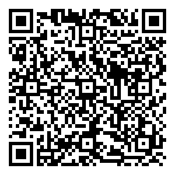
Employee-Sourced Risk Intelligence
Get Instant Updates
Broadcast messages are displayed at the top of the home screen for quick access to information.
Settings
Access profile settings, manage your organizations, and get app help.
Request Help
Communicate with local emergency services and your organization’s safety officials – no matter where you are.
Access Information and Emergency Procedures
View important information from your organization, like emergency procedures and community resources.
SafeWalk
Invite friends to virtually walk you to your destination.
Tab Navigation: Home
See an overview of LiveSafe resources and updates from your organization.
Tab Navigation: Activity
Access past broadcast messages, check-ins, and chat conversations.
Submit Tips to Safety & Security
When you see something suspicious, share that info with your organization’s safety and security team.
Get LiveSafe
Using the QR code, download “LiveSafe” from the App Store or Google Play. Register and fill out your profile. Search for & select our organization. You’re set!
Notes:
TO UPDATE PHONE SCREEN: This is using an iPhone X for the base. Make sure you are replacing the app image with a screenshot taken from an iPhone X.
Right-click the iPhone X frame. Hover over “Send to Back” and select “Send Backward”. This will layer the app image above the phone frame so that you can easily select it and replace it with the updated image.
Right-click the app image. Select “Change Picture”.
Locate the screenshot you have already taken of the organization you are creating the launch kit for. Select it.
Right-click the updated screenshot you just dropped in. Hover over “Send to Back” and select “Send Backward”. This will layer the phone frame back on top of the app image.
TO UPDATE QR CODE: There are tons of options online for creating QR codes. One example is https://www.qr-code-generator.com/
Right-click the QR code. Select “Change Picture”
Locate the QR code you have generated for the organization you are creating a launch kit for. Select it.

